Slide 1
Tree-based Non-Parametric Models 1

Slide 2
Contents
Bayes’ Theorem
Bayesian Inference
Decision Tree & Bayesian Tree

Slide 3
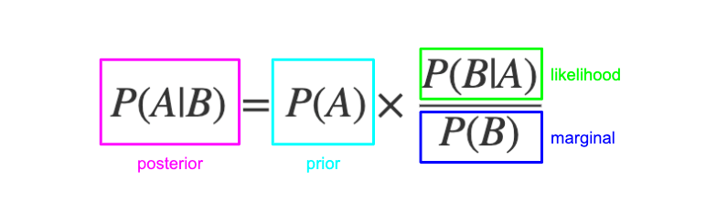
Bayes’ Theorem
Image source: https://www.freecodecamp.org/news/bayes-rule-explained/

Slide 4
Bayesian inference
Maximum Likelihood Estimation (MLE)
Does not require prior knowledge
Only estimator
frequentist interpretation of probability
Bayesian Inference
Need prior knowledge
Have the whole posterior
Bayesian interpretation of probability

Slide 5
Prior distribution
In some cases, prior distribution can be obtained from other data or knowledge. If not, you have to make assumptions.
Examples of prior distribution:
Uniform distribution
Beta distribution
Normal distribution

Slide 6
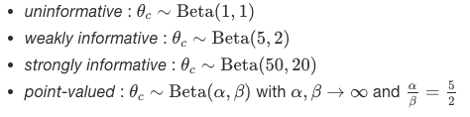
Prior distribution

Slide 7
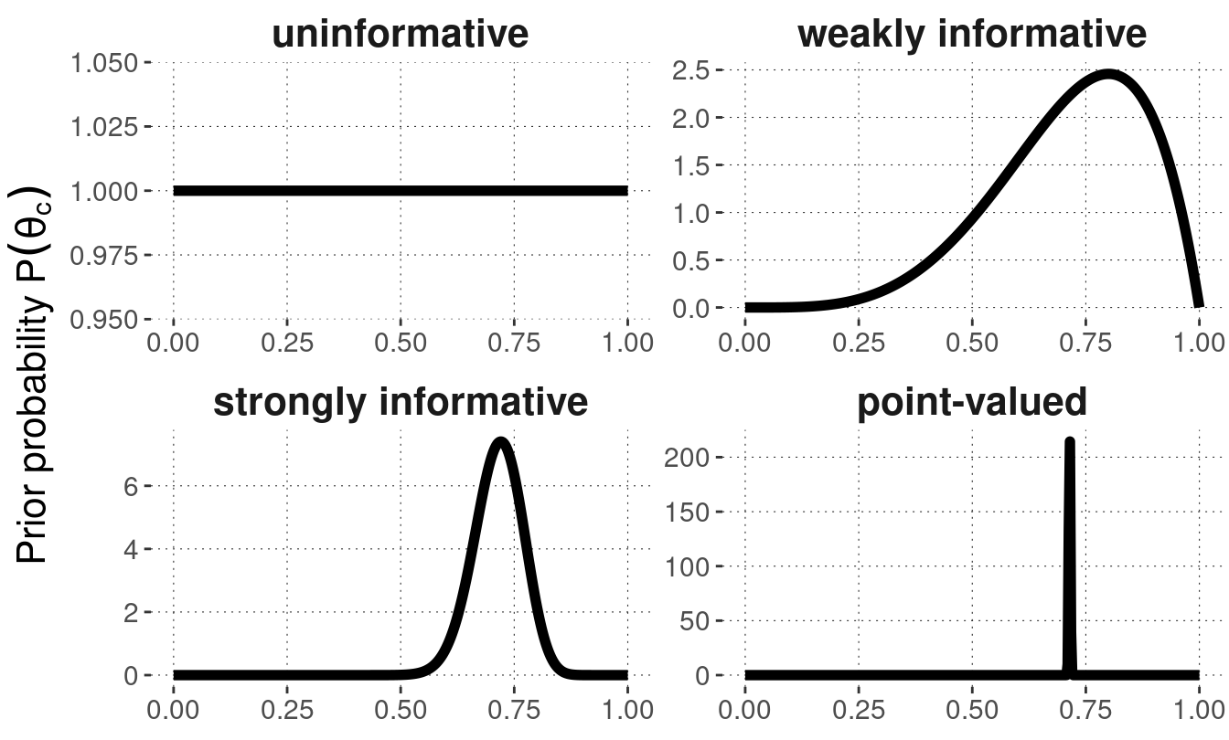
Prior distribution

Slide 8
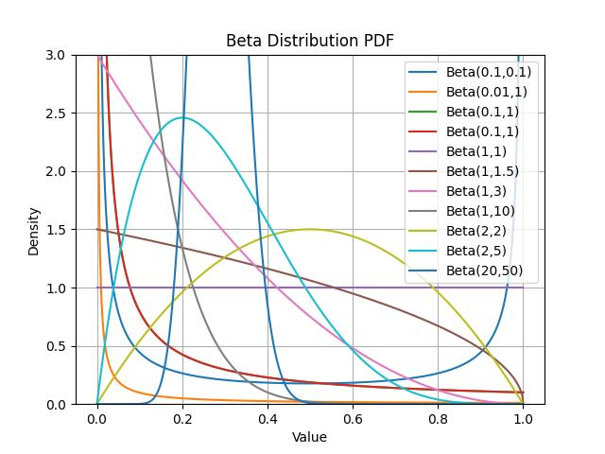
Prior distribution

Slide 9
Prior information
Prior information refers to the probability assigned to a parameter or an event in advance of any empirical evidence.
It’s the information or knowledge that you have before conducting an experiment or analysis.

Slide 10
Hyperprior & hierarchical models
Hyperprior is a prior distribution on a hyperparameter, that is, on a parameter of a prior distribution
Hierarchical models / Multilevel models are statistical models of parameters that vary at more than one level.
For example:
Dependent variable: Y ~ Normal(μ, constant). This is likelihood.
Prior: μ ~ Normal(M, constant). M is hyperparameter.
Hyperprior: M ~ Normal(z, constant)

Slide 11
Decision Tree

Slide 12
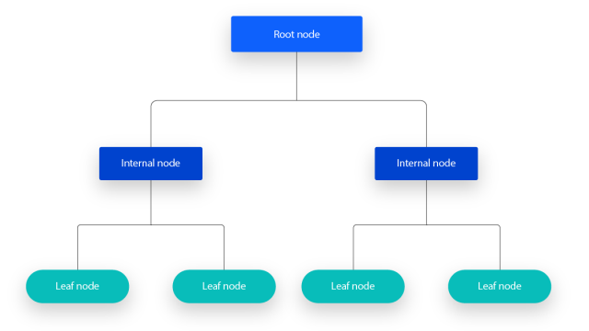
Decision Tree

Slide 13
ID3
ID3 (Iterative Dichotomiser 3): A classification algorithm that builds a decision tree by using entropy and information gain to choose the best attribute at each node. It works only with categorical data and doesn't handle missing values or overfitting.
C4.5: An improvement over ID3 that can handle both continuous and categorical data. It introduces the gain ratio to reduce bias towards attributes with more categories and includes mechanisms for dealing with missing data and pruning trees to combat overfitting.
CART (Classification and Regression Trees): A versatile algorithm for both classification and regression tasks. It uses Gini impurity for classification and variance reduction for regression to split data. CART builds binary trees and includes techniques like pruning to avoid overfitting.
ID3 only supports categorical data.

Slide 14
ID3

Slide 15
ID3
Common termination conditions
All data is one class
Minimum number samples
Maximum depth reached
Then majority is choosen.

Slide 16
C4.5
C4.5 made a number of improvements to ID3. Some of these are:
Handling both continuous and discrete attributes
Using Gain Ratio for Splitting Criteria
Pruning trees after creation - C4.5 goes back through the tree once it's been created and attempts to remove branches that do not help by replacing them with leaf nodes.
Handling training data with missing attribute values

Slide 17
C4.5
After sorting, C4.5 identifies potential split points (also known as "cut points" or "thresholds") between every pair of consecutive instances that belong to different classes. Each potential split point is the midpoint between the values of these consecutive instances.
Attribute "Age”: [5, 8, 10, 15, 18]
whether a child likes a specific toy [Likes, Likes, Doesn't Like, Doesn't Like, Likes]
The midpoint will be 9 and 16.5

Slide 18
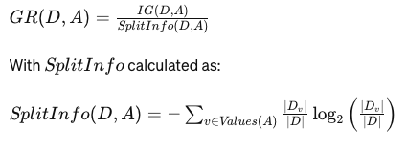
C4.5

Slide 19
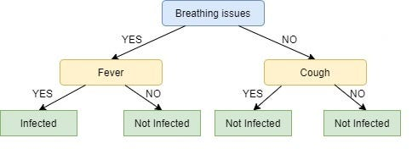
Pruning

Slide 20
Pruning
One of the simplest forms of pruning is reduced error pruning.
Starting at the leaves, each node is replaced with its most popular class. If the prediction accuracy is not affected or even better, then the change is kept.

Slide 21
CART
CART (Classification And Regression Trees) has been developed by Breiman, Friedman, Olshen, and Stone in 1984.
Both classification and regression tasks
Handling both continuous and discrete attributes
Using Gini impurity for Splitting Criteria
Pruning trees after creation
CART adopts normally non-categorical data.

Slide 22
CART
(The same as C4.5) after sorting, CART identifies potential split points (also known as "cut points" or "thresholds") between every pair of consecutive instances that belong to different classes. Each potential split point is the midpoint between the values of these consecutive instances.
Attribute "Age”: [5, 8, 10, 15, 18]
whether a child likes a specific toy [Likes, Likes, Doesn't Like, Doesn't Like, Likes]
The midpoint will be 9 and 16.5

Slide 23
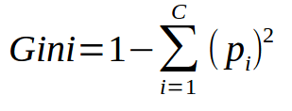
CART
Gini impurity measures how often a randomly chosen element of a set would be incorrectly labeled if it were labeled randomly and independently according to the distribution of labels in the set.

Slide 24
Pruning

Slide 25


Cost-Complexity Pruning
Minimize Cost-Complexity Function
r(t) is misclassification errors of that node.
p(t) is proportion of data ( # of items divided by # of all training items)
f(T) is the set of leaves.

Slide 26
Bayesian decision tree
The key idea behind Bayesian decision trees is having a posterior distribution over the possible trees. And choose the tree with the best posterior distribution.
BUNTINE’s Bayesian classification tree
Greedy-Modal Tree (GMT)
CGM’s Bayesian CART
DMS’S Bayesian CART
…

Slide 27
Additional materials

Slide 28
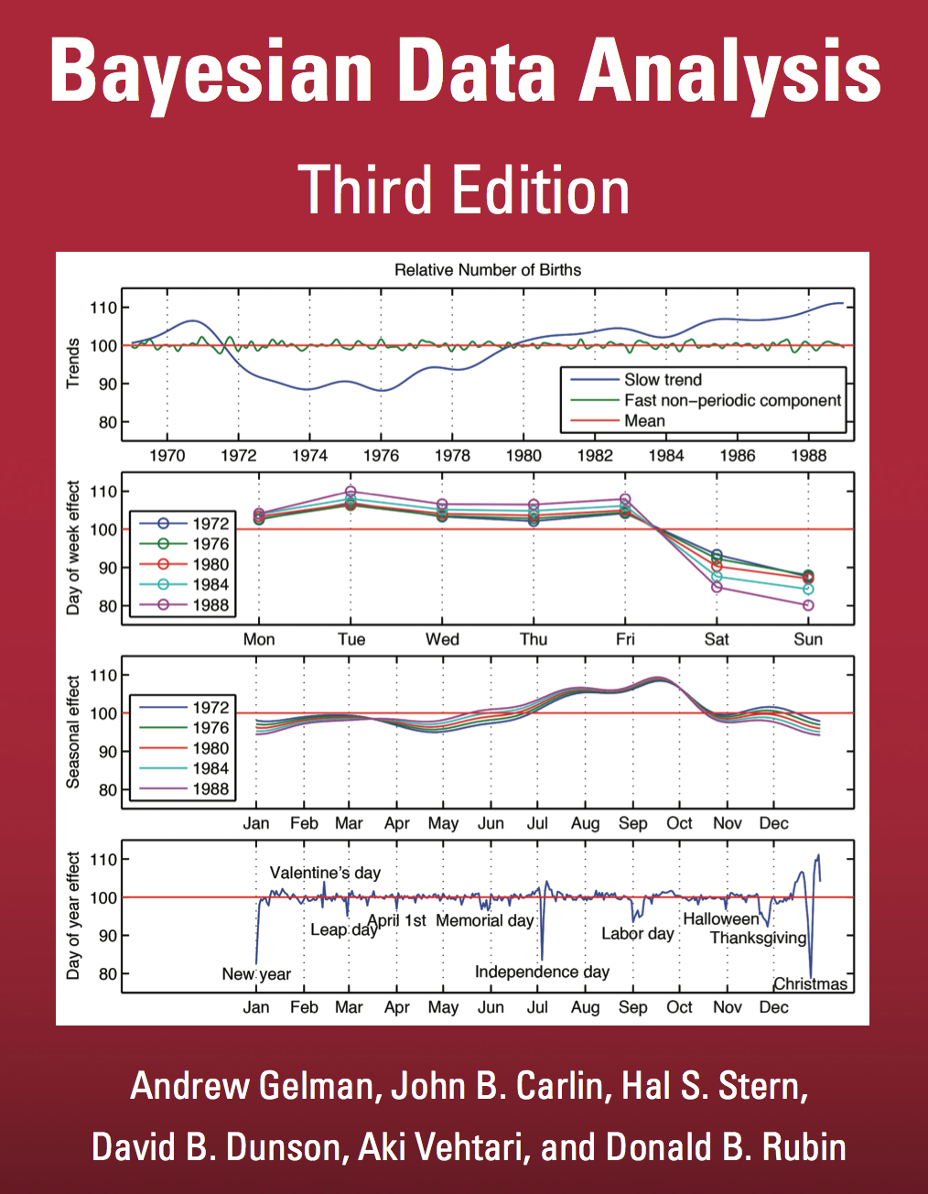
Bayesian Data Analysis
http://www.stat.columbia.edu/~gelman/book/

Slide 29
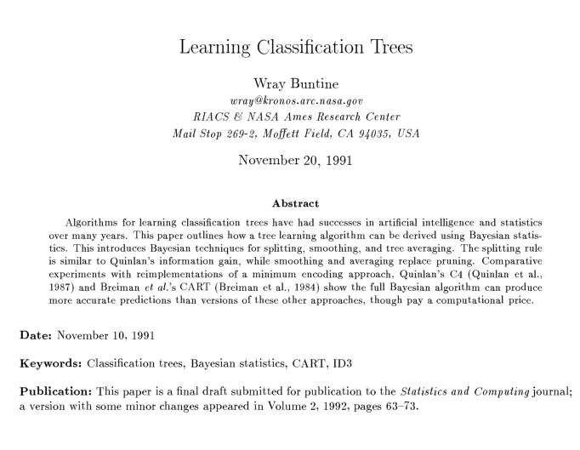
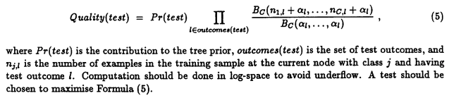
BUNTINE’s Bayesian classification tree
https://ntrs.nasa.gov/api/citations/19920016875/downloads/19920016875.pdf

Slide 30
Thank You

Slide 31
Thank You

